Slide 1
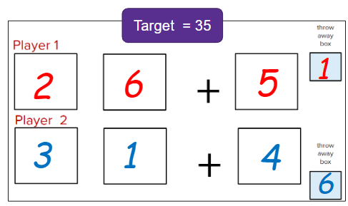
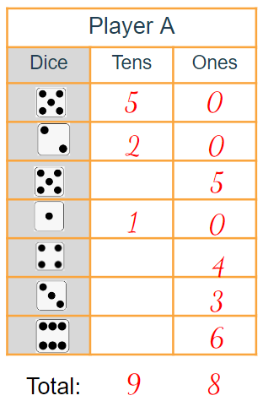
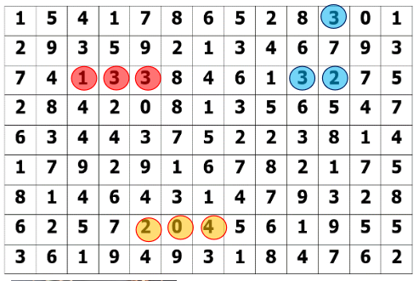
A starter collection of RecallNreason Games
Teachers are sharing their ideas and insights with these resources on our facebook page
TLF Maths: ideas and insights | Facebook

Slide 2
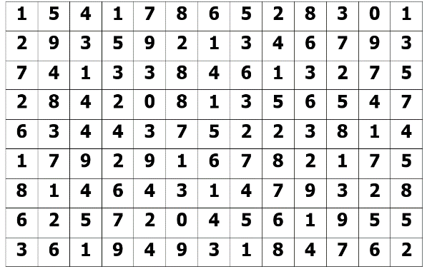
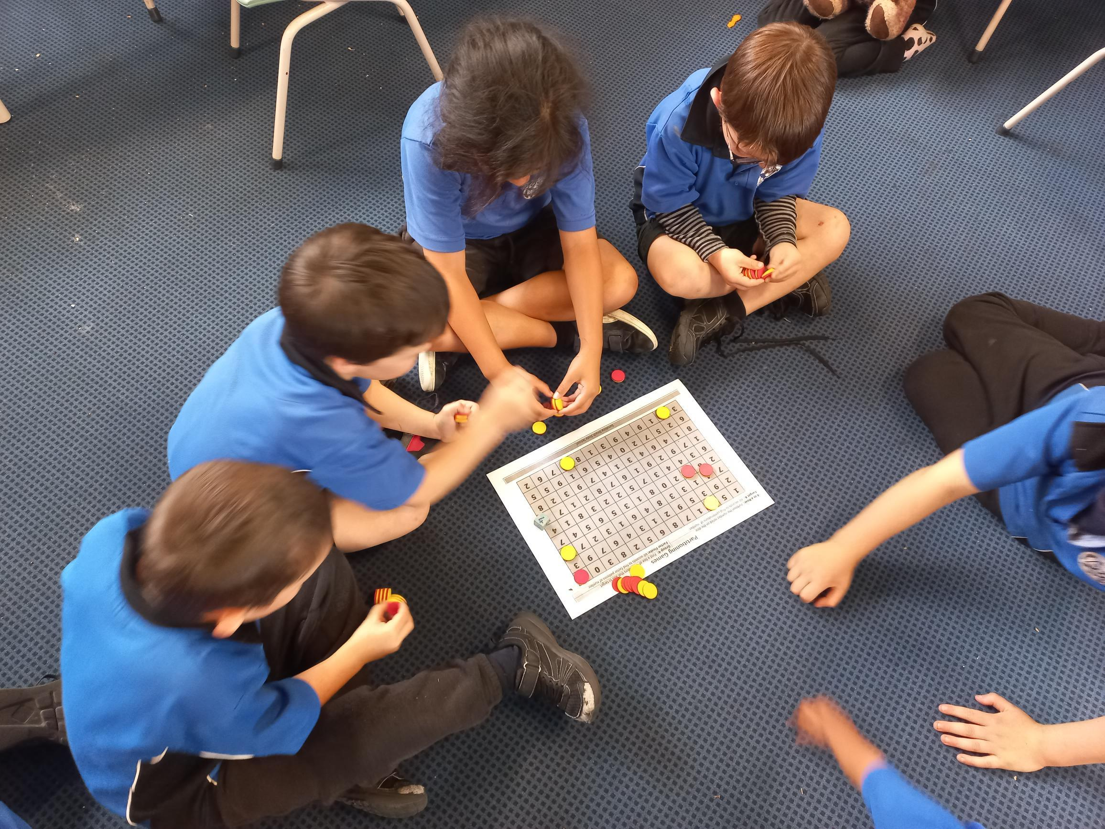
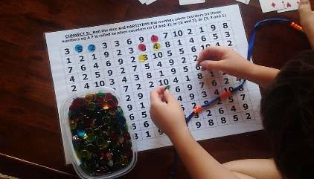
Partition Party Years 1 to 6
Materials: Number grids gameboard MM, translucent counters, 10 sided dice (or playing cards) beads, ten frames,
Maths concepts: Number facts and partitioning
Aim: Be the first player to get ..... 5 counters in a row
Player A rolls a 10 sided dice and decides how to partition it eg 8 could be partitioned as 4 + 4 or 3 + 2 + 3 or 7 + 1 etc
They place counters on the board to show this.
Player B checks to justify this
Player B rolls the dice and has their go. E.g. 7 = 3 + 3 + 1
Keep going until a player has 5 in a row
Extend and enable ideas?
Notes:
Extend and Enable:
Zero can be used once each turn if justified e.g. 6 =4 + 2 + 0
Target is to get an array e.g. 3 digits by 2 digits
Target number is given e.g. 8 and there is a race to cover consecutive numbers that have this sum or difference
Change the numbers on the board

Slide 3
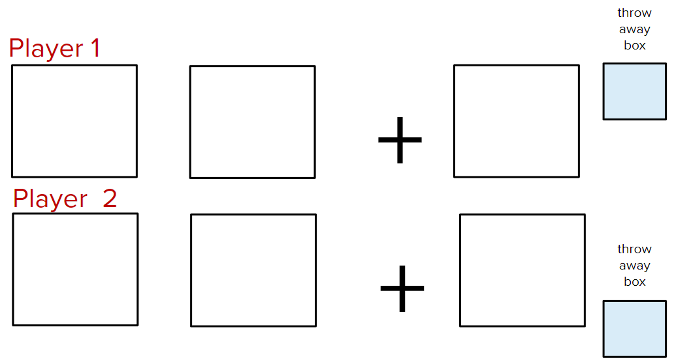
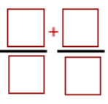
Target = 35
Number Boxes Years 1 to 8
Materials: 6 sided dice, pen and paper
Maths concepts: computation, place value
Aim: Be the closest to the target number
Choose which number box layout you want to play and decide on a specific target number to aim for, e.g. 35
Players take turns to roll a dice and place it somewhere in one of their boxes.
Once the number has been placed, it cannot be moved. One number on any given round may be “thrown away” and written in the throw away box instead.
Play continues until all of the boxes are full. Players justify which number is closest to the target number.
Extend and enable ideas?
1
2
6
5
3
1
4
6
Notes:
Extend and Enable:
Represent numbers using place value materials or number line
Vary the number and layout of the number boxes
Use 10-sided die
Nice or Nasty Version – players choose to keep their number thrown or pass it to their opponent to use.

Slide 4
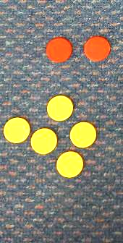
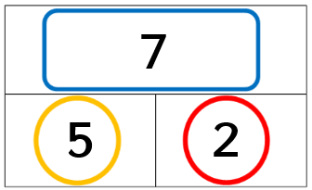
Shake and Drop Years 0 - 3
Materials: double-sided counters, paper, other counting materials
Maths Concepts: number facts and partitioning
Aim: partition numbers to create number sentences
Shake, drop and sort the counters
Write this as part whole fact family
Create one addition and one subtraction equation
Prove to each other that both are correct by turning them into an oral story and representing them with materials
Extend and enable ideas?
Notes:
Extend and enable
Use different totals e.g. 5 or 10
Create 4 number sentences for each drop
Assessment Tips
Do they use count on, count all, skip count, early strategies?
Can they show a collection from a given story?

Slide 5
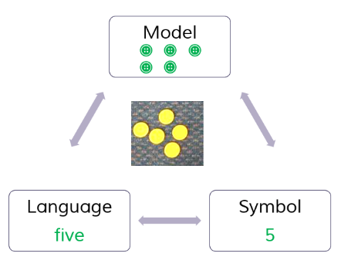
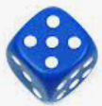
Race to 10 Year 0 – 2
Materials:
ten frames, 6-sided die, counters, number lines to 20
Maths concepts: number bonds to 10 (or 20)
Aim: Be first to reach exactly 10
Players take turns to roll a die
Count and collect that many counters (match number to concrete), e.g. Roll 5
Place counters onto the tens frame (or number line to 20)
Prove how many more they need to make 10 (or 20)
eg I have 5 counters and I need 5 more to make 10
Extend and enable ideas:
Notes:
Extend and enable ideas
Work back from 10 ( taking away)
Use a number line to 20 and encourage counting/additive
Only odd numbers can be used
Enable ideas:
Race to 5 - use a blank die with 1,2,3 or 0,1,2
Use large ten frames with chalk outside, bodies as counters

Slide 6
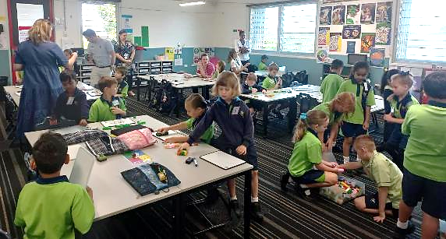
Player B
Towers Year 0 – 2
Materials: connecting blocks (unifix), dice
Maths concepts: Language of comparison, encourage subitising
Aim: Have the highest score by collecting the difference.
Both players share some blocks (30-40 is best)
They take turns to roll the dice and collect that number of blocks and connect them to make a tower
They directly compare their towers and describe the difference, eg my tower is bigger, it has 1 more than yours
The player with the bigger tower snaps off the difference between the two towers and adds this number to their score (Can use a whiteboard or number line to show cumulative scores)
After 5 rounds the highest scores wins. Rotate partners
Extend and enable ideas:
Player A
“My tower is bigger, it has 1 more than yours”
Player B gets 1 point

Slide 7
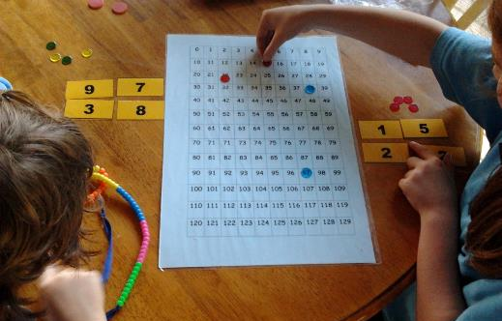
Round | Player 1 | Player 2 | Player 3
1
2
3
4
5
In the Middle Year 0 – 6
Materials: paper, 2 dice, manipulatives
Maths concepts: place value, sequence and order
Aim: Get the number in the middle in each round.
Each player takes turns to roll 2 die, creates a 2-digit number and writes it in the table . E.g.
Player 1 rolls a 2 and 5 (25 or 52)
Player 2 rolls a 1 and 6 (16 or 61)
Player 3 rolls a 3 and 3 (this can only be 33)
2. Players take turns rolling first, second or third in each of the next rounds.
Extend and enable ideas:
25
33
16
Player 1 wins this round

Slide 8
Gnarly Numbers Year 0 – 6
Materials: 0-9 number generator (e.g. 10-sided dice or playing cards), paper/whiteboard
Maths concepts: place value, addition
Aim: Use addition to reach a target number (100)
Five digits are selected (or rolled) eg 2,5,9,3,1
Player A takes 2 of the digits to create a 2-digit number
Player B takes 2 of the digits to create a 2-digit number
5th digit discarded and 5 more numbers are chosen
Player B takes 2 digits to create a 2nd 2-digit number
Player A takes 2 digits to create a 2nd 2-digit number
Both players add their numbers together and the one closest to 100 is the winner
Extend and enable ideas:
2
5
9
3
1
Player A
Player B
5
9
1
3
90 =
= 97
3
1
8
4
4
4
3
8
3
3
1
3
1
Source: James Russo

Slide 9
Greedy Pig Year 0-6
Materials: paper, dice
Maths Concepts: addition, probability
Aim: get the highest final score after a number of rounds.
Everyone in the class stands up.
The teacher (or delegate) rolls the dice and everyone records the score on the dice.
You choose to bank the score and sit down or continue for another roll of the dice.
If a one comes up on the dice and you are still standing, your total is zero and this round is over.
A final score is the sum of the five scores from each of the rounds.
Extend and enable ideas?
Greedy Pig
Round | Score | Total
1
2
3
4
5
Final score
Source: nzmaths
Notes:
Extend ideas:
Play more rounds
Roll 2 dice, 3 dice
10-sided dice, spinner
Multiply the dice
Explore concepts of probability
Enable ideas:
Use manipulatives/drawings to assist with adding/counting on
Use six as the “bad” number (addition qith numbers 1-5 only)

Slide 10
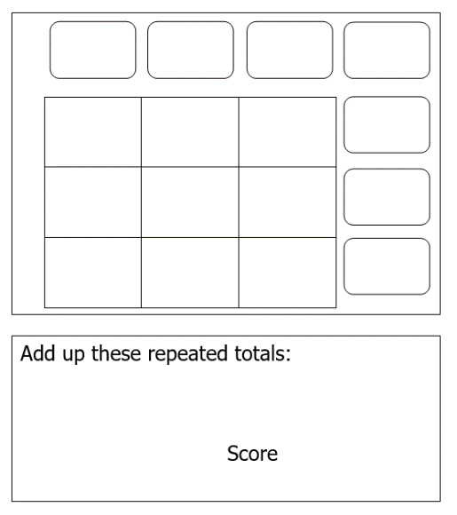
Add ‘em Ups Year 0-8
Materials: dice (6-sided or 10 sided)
Maths Concepts: addition
Aim: Get the highest total. Your score comes from totals of rows or columns that are repeated (this is the strategy).
Players take turns to roll the dice.
As each number is rolled players decide where to place it somewhere in the grid
Students can add columns or rows as numbers are placed to create totals.
After 9 rolls all numbers and totals should be entered into boxes
Totals that are repeated can go towards the final score e.g. 8 is not allowed as there is no other 8 in the totals.
Extend and enable ideas?
9
9
12
8
5
2
2
9
3
5
4
12
1
2
6
9
9 + 9 + 9 + 9 + 12 + 12
60
Source: nzmaths
Notes:
Extend ideas:
Play more rounds
Roll 2 dice, 3 dice
Use fractions or decimal dice
10-sided dice, spinner
Multiply the dice
Explore concepts of probability
Enable ideas:
Use manipulatives/drawings to assist with adding/counting on
Use six as the “bad” number (addition qith numbers 1-5 only)

Slide 11
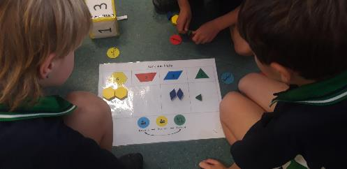
6 | 3 | 2 | 1
Traders Year 0-3
Materials: Pattern Blocks, A3 board, dice with digits 1,2,3,
Maths Concepts: Understand the role of trading before using place value.
Aim: Build the largest total with the least amount of shapes. Rule: no more than 2 shapes in the 1, 2, or 3 columns.
Assign a banker, checker and pair of players
Players roll dice e.g. 3 and banker gives them 3
Players place the 3 onto the column which means the players must automatically trade up – they give two to the banker and the banker gives a
The checker gets the players to prove the total is still the same, if not, those are taken away.
After a set time (e.g. 5 minutes) the total is recorded
The banker and checker swap with the two players
Players lose a turn if they forget to trade or cannot defend their total
Source: nzmaths
Extend and enable ideas?
Notes:
Extend d enable ideas:
The banker can give incorrect amounts to keep pair vigilant
Start with 3 or 4 yellow hexagon s and dice rolls subtract with this – decompose
Students invited to come up with new variations

Slide 12
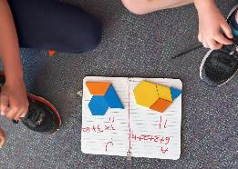
6 units | 3 units | 2 units | 1 unit
Mix and Match Year 1-8
Materials: Pattern Blocks, dice with digits 1,2,3,
Maths Concepts: addition, proportions
Aim: Explore ways to create target numbers and record options as number sentences
A target number is selected e.g. 12 or 15
Students use the pattern blocks to explore different representations of these numbers
Students use number sentences to justify how the target number was achieved.
Tip: Teachers’ observations can identify which number strategies students default to; counting, additive etc.
Today’s number : 15
15 = 6 + 2 + 2 + 2 + 2 + 1
15 = 6 + (4 twos) + 1
6 + 6 + 3 = 15
Extend and enable ideas?
Notes:
Today the trapezium is worth 1. Your target number is 8
Today the triangle is worth 1/2. Your target number is 41/2
Build a shape worth 𝑥 in 6 shapes

Slide 13
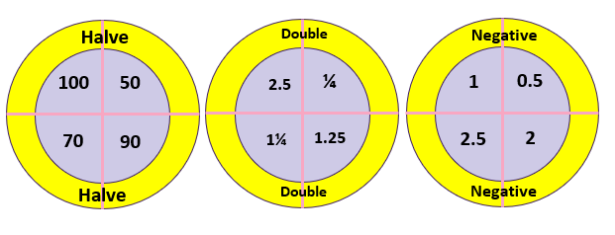
Targets Year 0-8
Materials: white boards, manipulatives, number lines
Maths Concepts: operating with numbers
Aim: Explore multiple ways to reach the target number
A target number is chosen from a pre selected board:
Explore ways to reach the total using 3 arrows.
Jot down each solution as a number equation searching for patterns and relationships as they explore
Double
3
5
6
2
Double
Notes:
Extend and enable ideas?
Changing numbers- 2-digit, 3-digit, fractions, decimals
Changing values – double, halve, x10, ÷10, negative
Immediate prompts- “no dart in the same quadrant”, “one arrow today subtracts a number”, “multiply the dart totals together”, “create your own board, own game”
Get your learners to create their own and take them home

Slide 14
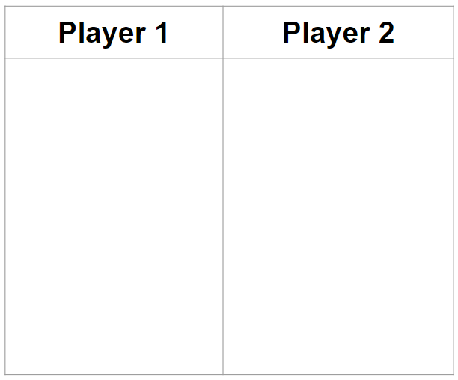
Knock Out Year 0-8
Materials: 2 dice, pen and paper
Maths Concepts: addition
Aim: Get the highest total after 10 rolls
Players take turns to roll the 2 dice ten times.
On each turn they write the sum of the dice in their column., e.g. roll a 5 and 3 = 8
If a player rolls a total of 7 they cross out all of their previous scores.
The winner is the person with the highest total after 10 rolls
8
6
11
9
5
7
3
4
Extend and enable ideas?
Notes:
Extend and enable ideas?
Changing the dice values – multiples of 10,

Slide 15
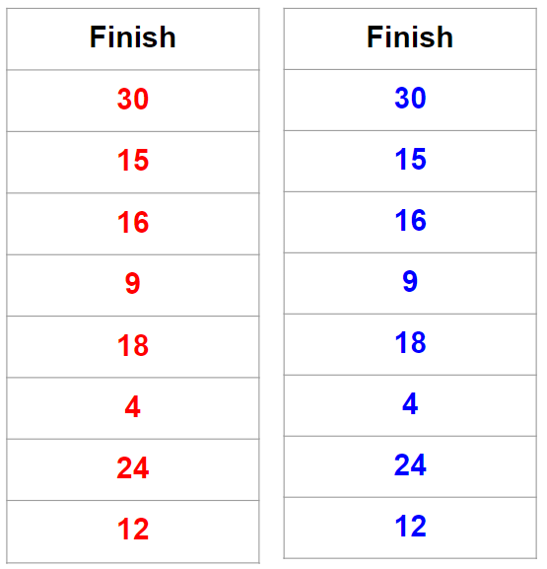
Is it Divisible? Year 1-6
Materials: 1-6 dice, pen and paper, manipulatives
Maths Concepts: division
Aim: Be first to get to the top of the ladder
Each player starts with their counter on 12 and take turns to roll the dice.
If the number the counter is on can be divided by the number that is thrown on the dice (with no remainder) then they can move up one step, e.g. if they start at 12 and roll a 6, they can move 1 place up to 24 as 12 is divisible by 6
If a player throws a 1, they choose a number (from 2-6)
If the number is not divisible, they must stay on that number until they roll a number that is divisible .
Winner is the first person to get to the top of the ladder.
Extend and enable ideas?
Notes:
Extend and enable ideas?
Change the ladder values and use 1-10 dice values

Slide 16
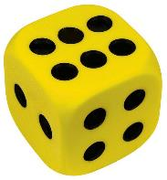
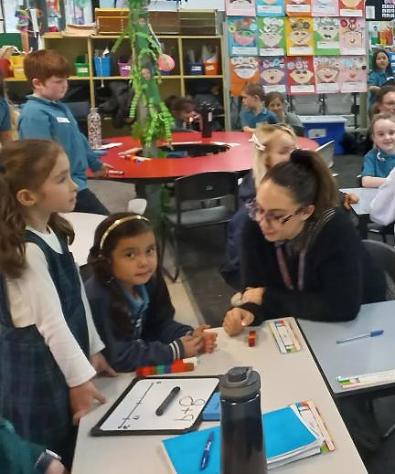
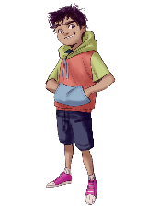
4 in a line Year 1-8
Materials: number lines/number strips, white boards, 2 dice (6 or 10 sided)
Maths Concepts: ordering, place value
Aim: Get three uninterrupted crosses in a line
Players take turns to roll 2 dice choose a number to cross out on the line, e.g. 6 and 5 could be 56 or 65
They decide where to place it on the number line. Their opponents request they prove it is in a reasonable place to keep cross there.
Next pair roll and choose a place. They get this justified
Repeat until one pair gets three in a row
15
13
26
31
45
52
56
62
Player A
6 and 5 = 56
Player B
1 and 5 = 15
Player A
2 and 6 = 62
Player B
4 and 5 = 45
Player A
3 and 1 = 13
Player B
3 and 1 = 31
Player A
2 and 5 = 52
Player B
2 and 6 = 26
Extend and enable ideas?
Notes:
Extend and enable ideas?
10 sided dice
Change the scale to use decimals or fractions
Include questions on probability of outcomes
Use 3 dice for 3 digit numbers on a 1-100 line or number board\
Students create their own rules for when they want cross out a number that already exists.

Slide 17
Tricky Operations Year 1-8
Materials: pen (different colour per player), whiteboard, number line
Maths Concepts: multi-step equations, order of operations
Aim: Get four uninterrupted crosses on the number line
Choose 9 rational numbers to place in the grid (include at least 1 fraction and 1 decimal number)
Player A creates a number sentence using one operation, e.g., 8+1 = 9 and prove to Player B where it goes on the line
If Player B is convinced, Player A places their cross
Player B then has their go, e.g. 10x 2= 20. Play continues until one player has 4 crosses in a row
BUT: You can steal numbers back by:
adding an extra operation, e.g. steal 7 back 9+3–5= 7.
using a fraction, or decimal, or brackets, or exponents
0
7
9
20
5 | 10 | 12
2 | 8 | 1
3 | 9 | 7
Adapt by changing numbers on the grid and numberline
5 | 10 | 12
2 | 0.2 | 1
3 | 9 | ¼
Extend and enable ideas?
Notes:
Extend and enable ideas?
Change the numbers in the grid and on the number line

Slide 18
Multiply Max Year 1-8
Materials: 10-sided dice (or use playing cards), paper / whiteboards, pen
Maths Concepts: multiplication and addition
Aim: Have the highest total (or closest to a given target number chosen at the start)
All players write down six different numbers between 1 and 10 (in the left column of their table)
A dice is rolled and the number is called out, e.g. ‘3’
All players choose one of their numbers to multiply with the dice and writes this number and the corresponding product into their table.
Repeat for 6 rolls of the dice (i.e.when all numbers have been chosen once).
The winner is the player with the highest total (or closest to a given target number chosen at the start)
My number | Dice Roll | Product
5
8
2
4
1
7
Total
My number | Dice Roll | Product
5 | 3 | 15
8 | 6 | 48
2 | 2 | 4
4 | 3 | 12
1 | 2 | 2
7 | 5 | 35
Total |  | 116
My number | Dice Roll | Product
4
9
5
2
7
6
Total
My number | Dice Roll | Product
4 | 2 | 8
9 | 6 | 54
5 | 3 | 15
2 | 2 | 4
7 | 3 | 21
6 | 5 | 30
Total |  | 132
3
15
3
21
5
35
5
30
Extend and enable ideas?
(source: adapted from Professor Mike Askew)
Notes:
Extend and enable ideas?
Change dice – 6 sided, 4 sided, 8 sided, 12 sided
Change operation – difference betwen numbers, sum of numbers
Change target – lowest score, highest score (less strategy needed)

Slide 19
Rounding Game Year 3-8
Materials: 10-sided dice (or use playing cards), paper / whiteboards, pen
Maths Concepts: place value and rounding
Aim: Be first to complete their table (after 10+ rolls of the dice)
All players draw a table with multiples of 100 (100 -1000)
Three dice are rolled e.g. 1, 7 and 6 and all players use the digits to create a 3-digit number of their choice which they write next to the nearest hundred in the table.
Play continues until one player has completed all of their table, e.g. after 10 rolls of the dice). If a player can’t place their 3 digit number into their table they miss that go.
Alternative version of a ‘winner’
Players work out the differences and find the total. The winner is the person with smallest difference.
 | Number | Difference
100
200
300
400
500
600
700
800
900
1000
176
671
29
761
Total:
Extend and enable ideas?
Notes:
Extend and enable ideas?
Change dice – 6 sided, 4 sided, 8 sided, 12 sided
Change operation – difference betwen numbers, sum of numbers
Change target – lowest score, highest score (less strategy needed)

Slide 20
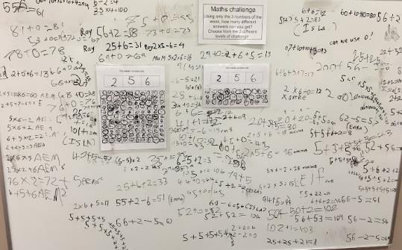
0 | 1 | 2 | 3 | 4 | 5 | 6 | 7 | 8 | 9
10 | 11 | 12 | 13 | 14 | 15 | 16 | 17 | 18 | 19
20 | 21 | 22 | 23 | 24 | 25 | 26 | 27 | 28 | 29
30 | 31 | 32 | 33 | 34 | 35 | 36 | 37 | 38 | 39
40 | 41 | 42 | 43 | 44 | 45 | 46 | 47 | 48 | 49
50 | 51 | 52 | 53 | 54 | 55 | 56 | 57 | 58 | 59
60 | 61 | 62 | 63 | 64 | 65 | 66 | 67 | 68 | 69
70 | 71 | 72 | 73 | 74 | 75 | 76 | 77 | 78 | 79
80 | 81 | 82 | 83 | 84 | 85 | 86 | 87 | 88 | 89
90 | 91 | 92 | 93 | 94 | 95 | 96 | 97 | 98 | 99
100 | 101 | 102 | 103 | 104 | 105 | 106 | 107 | 108 | 109
Extend and enable ideas?
Notes:
Extend or Enable Ideas
Use 4 or 5 digits for younger learners
Find just 4 consecutive numbers, e.g. horizontally, vertically or diagonally
Find a whole line
Look for certain number properties, e.g. multiples of….
How many numbers can we get…
For a Whole school activity – announce the numbers over the loud speaker
Turn the answers into a problem solving activity, e.g. Using the digits 2, 5 and 6 – can you work out how students got these answers: 13, 67, 69

Slide 21
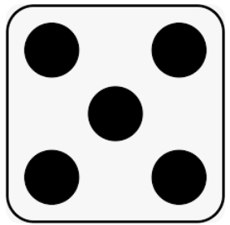
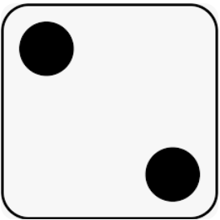
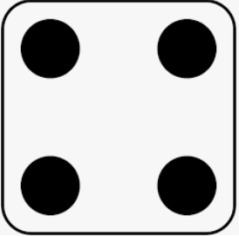
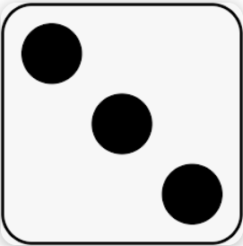
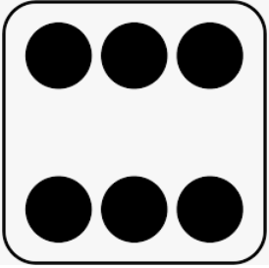
100 or Bust Year 1-8 1-8
Materials :6 or 10 sided dice, scrap paper/whiteboards
Maths Concepts: Place Value, Addition
Aim: Get the closest to or exactly 100 without going over
Draw a table with 7 empty rows
Players take turns to roll the dice and decide what value the digit is and enter it into a row, e.g. 5 could be written as 50 or 5
Try and keep a running total of your total score in your head after each roll
After 7 rolls each, players total their score – the player who got closest to 100 without going over wins.
Player A
Dice | Tens | Ones
5
0
2
0
5
1
0
4
3
6
Extend and enable ideas?
Total:
9
8
Notes:
Extend or Enable Ideas
Use 3 digits
Use decimals

Slide 22
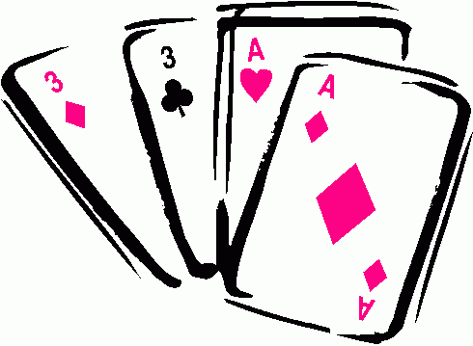
String Sums Year 1-6
Materials: 0 -6 digit cards (or dice)
Maths Concepts: number operations
Aim: Get closest to the target number
Decide on a target number
Decide how to use the numbers 1-6 to crreate three 2-digit numbers to reach the target number
Prove who is the closest eg use a number line or PV materials
1
2
3
4
5
6
Target example = 100
Extend and enable ideas?
Use Two 3-digit numbers to reach a 3-digit target
Use a mix of operations e.g have + and -
Use a decimal point and decimals
Increase number of digits from 6 to 7 or 8
Create your own problem for someone else.:Give the 6 digits and the total to your friend and challenge them to solve what your numbers & operations are
2
4
5
1
3
6
+
+
** Observe appropriateness of strategies, their mathematical thinking

Slide 23
Decimal Difference Year 4-8
Materials: 0-6 dice ( or 0-10 dice) or use playing cards
Maths Concepts: decimal subtraction
Aim: Create the smallest difference
Players each roll four dice (or pick 4 playing cards)
They use 2 numbers to create a decimal to 1dp
Use the other 2 numbers to create another decimal
Players calculate the difference between both decimal numberss
Defend their answer using a number line
2 . 1
2 . 4
2. 4 – 2 . 1 = 0 . 3
Extend and enable ideas?
Use 2 digit whole numbers
Use 6 dice and decimals to 2dp
Mix decimal place value: Use 5 dice, make 2dp & 1dp

Slide 24
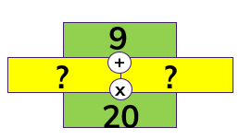
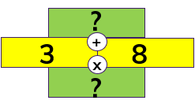
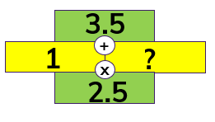
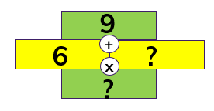
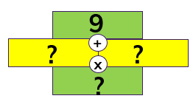
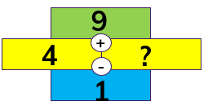
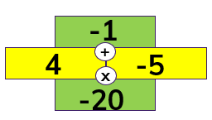
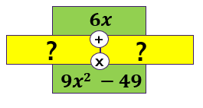
sum
9
Number Walls Year 1-8
Materials: pen, paper, materials to represent part/whole or factors etc.
Maths Concepts: addition, multiplication
Aim: Create number walls with missing elements to solve
Explain how a number wall work and how levels of cognition change depending on what element is missing
Provide number walls with elements missing in different positions to solve
Students create their own nnumber walls for others to solve
+
5
4
x
product
20
Vary the position of what is missing
Extend and enable ideas
You choose Change operation Use negative integers Use algebra
Game adapted from Peter Sullivan- 2017

Slide 25
Millions Year 7-8
Materials: 1-6 dice, pen, paper, place value houses grid.
Maths Concepts: exponents, addition, place value
Aim: Be the the first to get to 2 000 000
Players take turns to roll a dice e.g. 5
They represent this value as a power of 10 eg 10⁵ = 100 000
Place this value in their grid- prove why and pass dice.
The next player then has their turn.
On their nextrolls, the players add their new values but record it as a cumulative total in their grid.
MILLIONS |  |  | THOUSANDS |  |  | ONES
H | T | O | H | T | O | H | T | O
10⁸ | 10⁷ | 10⁶ | 10⁵ | 10⁴ | 10³ | 10² | 10¹ | 10⁰
 |  |  | 1 | 0 | 0 | 0 | 0 | 0
 |  |  | 1 | 1 | 0 | 0 | 0 | 0
 |  |  | 1 | 1 | 1 | 0 | 0 | 0
 |  |  | 2 | 1 | 1 | 0 | 0 | 0
 |  | 1 | 2 | 1 | 1 | 0 | 0 | 0
In the example above, the player rolled
5, 4 ,3, 5 and 6 (record an accumulative total)
Extend and enable ideas
PARTS OF ONE |  | THOUSANDTHS
T | H | O | T | H
1 ÷ 10 | 1 ÷ 100 (1÷10÷10) | 1 ÷ 1000 1÷10÷10÷10 | 1 ÷ 10000 | 1÷ 100000
10⁻¹ | 10⁻² | 10⁻³ | 10⁻⁴ | 10⁻⁵
10 sided dice – raise the target (include billions)
Use decimal houses – dice rolls are negative powers
Players choose to keep the dice number themselves or use it as a negative to subtract from their opponent’s grid
Stop once each player has a number in each column, then look who has highest/smallest total

Slide 26
PUZZLES

Slide 27
I am thinking of two numbers
Guess my Number
Discuss the possibilities
Defend your answers
The sum is
The difference is
The product is
12
4
32
Extend and Enable ideas
Enable by giving one of the two numbers
Enable by making product optional
Extend by including fractions and decimals
Extend by not giving all information and asking what numbers could work – open it up
Extend by hypothesising eg
if the sum is even then the difference must be odd
the difference is always smaller than the sum
the sum and difference can never be the same
?
?
Create your own and share them with each other and with us☺

Slide 28
12
? | ? | ?
? | ? | ?
? | ? | ?
9
? | ?
? | ?
24
18
23
16
14
19
22
17
Put different single digit numbers into the squares so that..
- the sum of blue squares is the same as the blue circle
- the sum of yellow squares is the same as the yellow circle
- the sum of the four squares is the same as the white circle
Variations
Include fractions, decimals, 2-digit numbers
Include other operations eg the number in the green circle could be the difference
Students create their own and share
Reduce cognition by removing a restriction eg no white circles

Slide 29
All these triangles follow the same pattern to work out what number goes in the middle.
3
4
3
3
6
3
8
4
3
2
Can you explain your thinking?
Can you create one of your own for us?
4
?
7
5
4
6

Slide 30
Domino Detectives
Aim – Solve and explain the mystery number
There is a pattern hidden in the dominoes that, once identified will help you work out what the missing number is?
Work out what you think the missing number is.
Explain your thinking.
Create another one like this to share
How could you change the puzzle to use different:
place value positions eg 3-digits, tenths and ones
Operations ( + - x ÷)
positions or number of dominoes
= 37
= 64
= 39
= ??
Get that creative thinking flowing

Slide 31
Seven Sums
A puzzle that promotes fluency of number facts
Can you put the numbers 1 to 7 in each of the coloured circles (once each) so that the total of every line is 12?
Is it possible to find another total they all add up to?
Is it possible to design one with 8 circles and the numbers 1 to 8, or even 9 that add up to the same total?

Slide 32
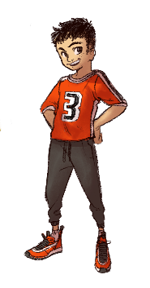
5
What’s on my back?
Two counters have different numbers on both sides
You toss the counters and get the product 20 (4 x 5)
What numbers must be on the other sides if all combinations of products are 8, 12 and 30?
4
Extend and Enable Ideas
Enable by using sum instead of product
Extend by getting students to create their own
Extend by asking students to explore the possibility of doing this with 3 counters
NZ kaiako Facebook group Maths: Ideas and insights TLF

Slide 33
Puzzle Time
Aim – Fill the boxes with the digits
0, 1, 2, 3, 4, 5, 6, 7, 8, 9
so that you have three correct solutions.
You may use each digit once only
You must use each of the digits 0-9
Extension -
Are there any more possibilities using the digits 0-9 to create a problem with similar or different operations?
+
=
-
=
X
=

