Slide 1
























Slide 2
Karakia
He mauri tō te tangata,
he whakapapa tōna,
he mana motuhake.
Everyone has mana. Everyone has a whakapapa, a genealogy, heritage and identity that makes that person no more and no less important than the next person.

Slide 3
Agenda for today
Whakawhanaungatanga: What’s on top
Kāhui Ako website
NZMaths Resources
Curriculum Refresh- One Hour a Day
TLF Mathematics and Statistics Progress Steps
TLF Effective Pedagogies Poster
ERO Report: Making it Count- Teaching Maths in Years 1-3
Future Planning

Slide 4

Kāhui Ako Website
https://www.kahuiakokimotueka.com
Resources Password: KAMotueka22

Slide 5
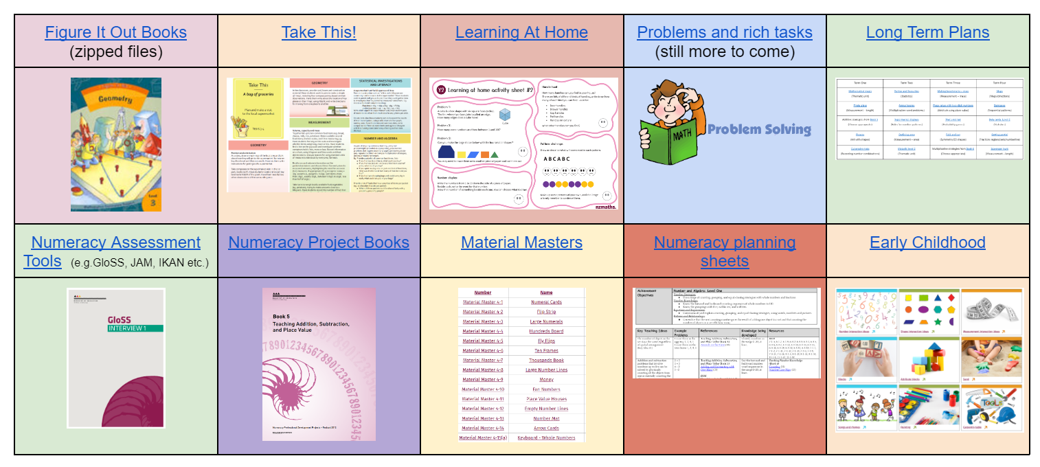
NZMaths resources
https://docs.google.com/document/d/1r13QlLcMhupqpAO-i4x_kz9bHHvg5Zhwc65scjbabJU/edit?usp=sharing

Slide 6
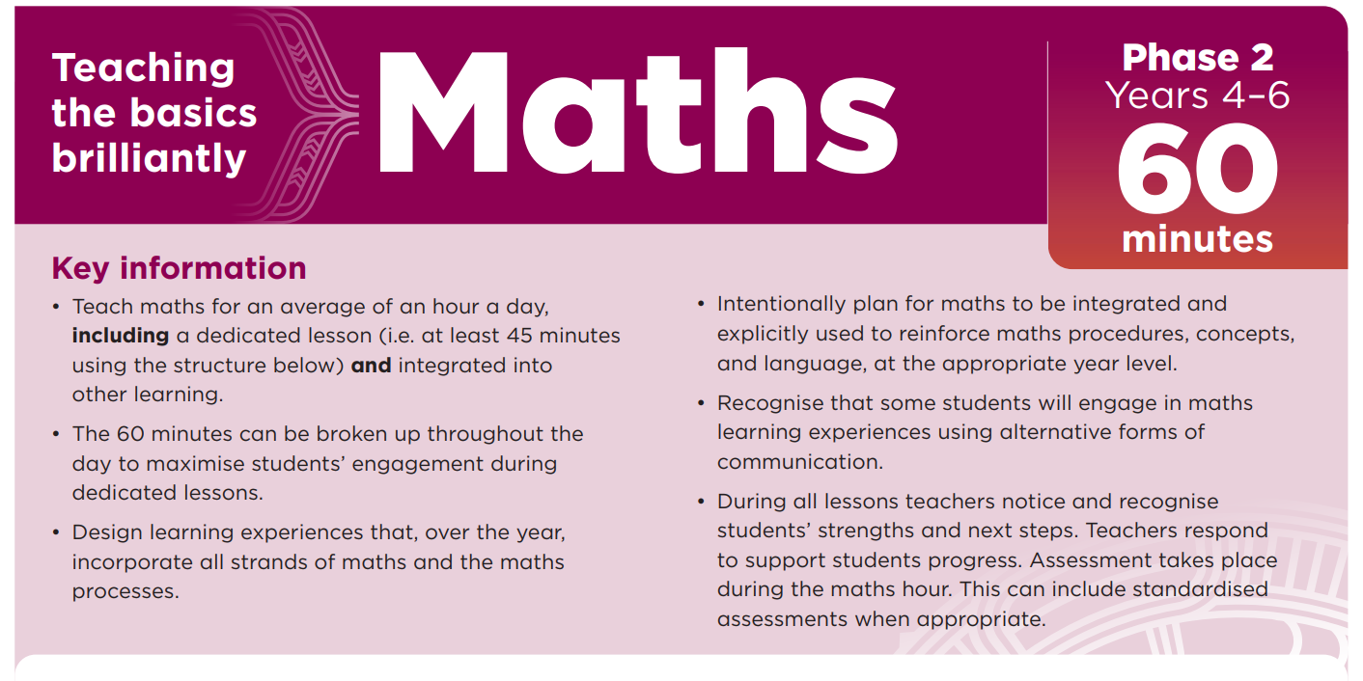
Curriculum Refresh- One hour a day
https://newzealandcurriculum.tahurangi.education.govt.nz/one-hour-a-day-reading-writing-and-maths-for-years-0-8/5637194830.p

Slide 7
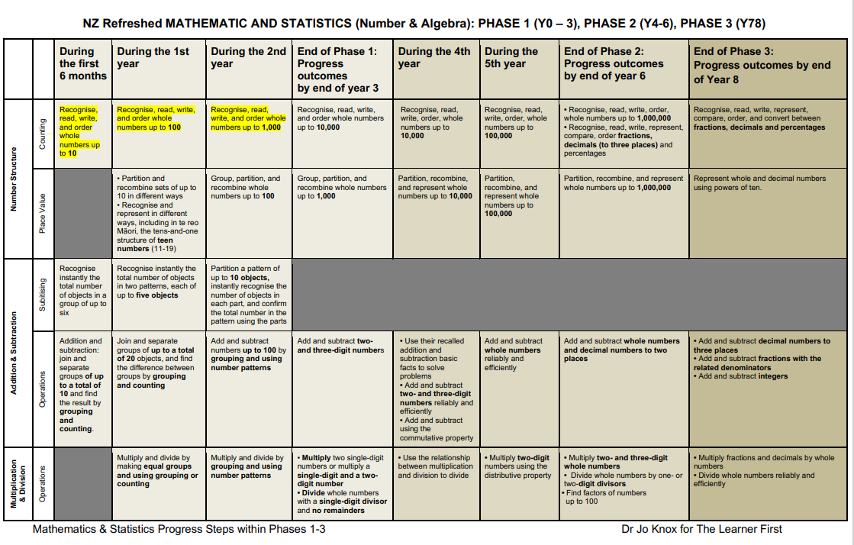
Mathematics and Statistics Progress Steps
https://drive.google.com/file/d/1awvP5vjJ-dumVUxjXwkEFLQkTPLfrK7H/view?usp=sharing

Slide 8
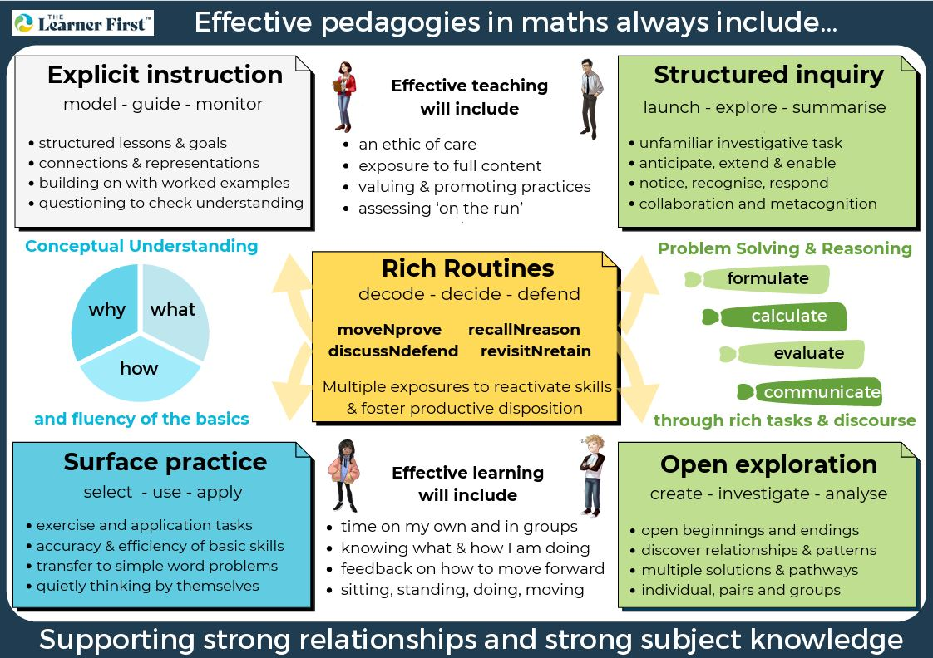
Rob Proffitt-White: A one pager showing our research based pedagogical approach for creating effective and sustainable teaching and learning in mathematics. Our work across AU and NZ enables schools to create a coherent line of sight that fits current and future maths curriculum reforms.
PDF: https://drive.google.com/file/d/1NU2M-xAc8qQR_isMQ9WD5aD-VtMosKgP/view?usp=sharing

Slide 9

ERO Report:
Making it Count- Teaching Maths in Years 1-3
https://evidence.ero.govt.nz/documents/making-it-count-teaching-maths-in-years-1-to-3
https://evidence.ero.govt.nz/media/hluht5p1/making-it-count-teaching-maths-in-years-1-3-good-practice-guide.pdf

Slide 10
Future Planning
What would you like future Maths Focus Group meetings to cover?
Bring to share- Maths Curriculum Overview

Slide 11
Closing Karakia - Whakamutunga
Karakia whakamutunga:
Kia tau iho te āio | May peace be dispersed
Ki runga i a mātou | Upon us all
Kua mutu ngā mahi | Our work is done
Kua tutuki, kua ea | Our goals are accomplished
Haumi e, hui e, tāiki e! | Let the day be done Tom Alesana

