Slide 1
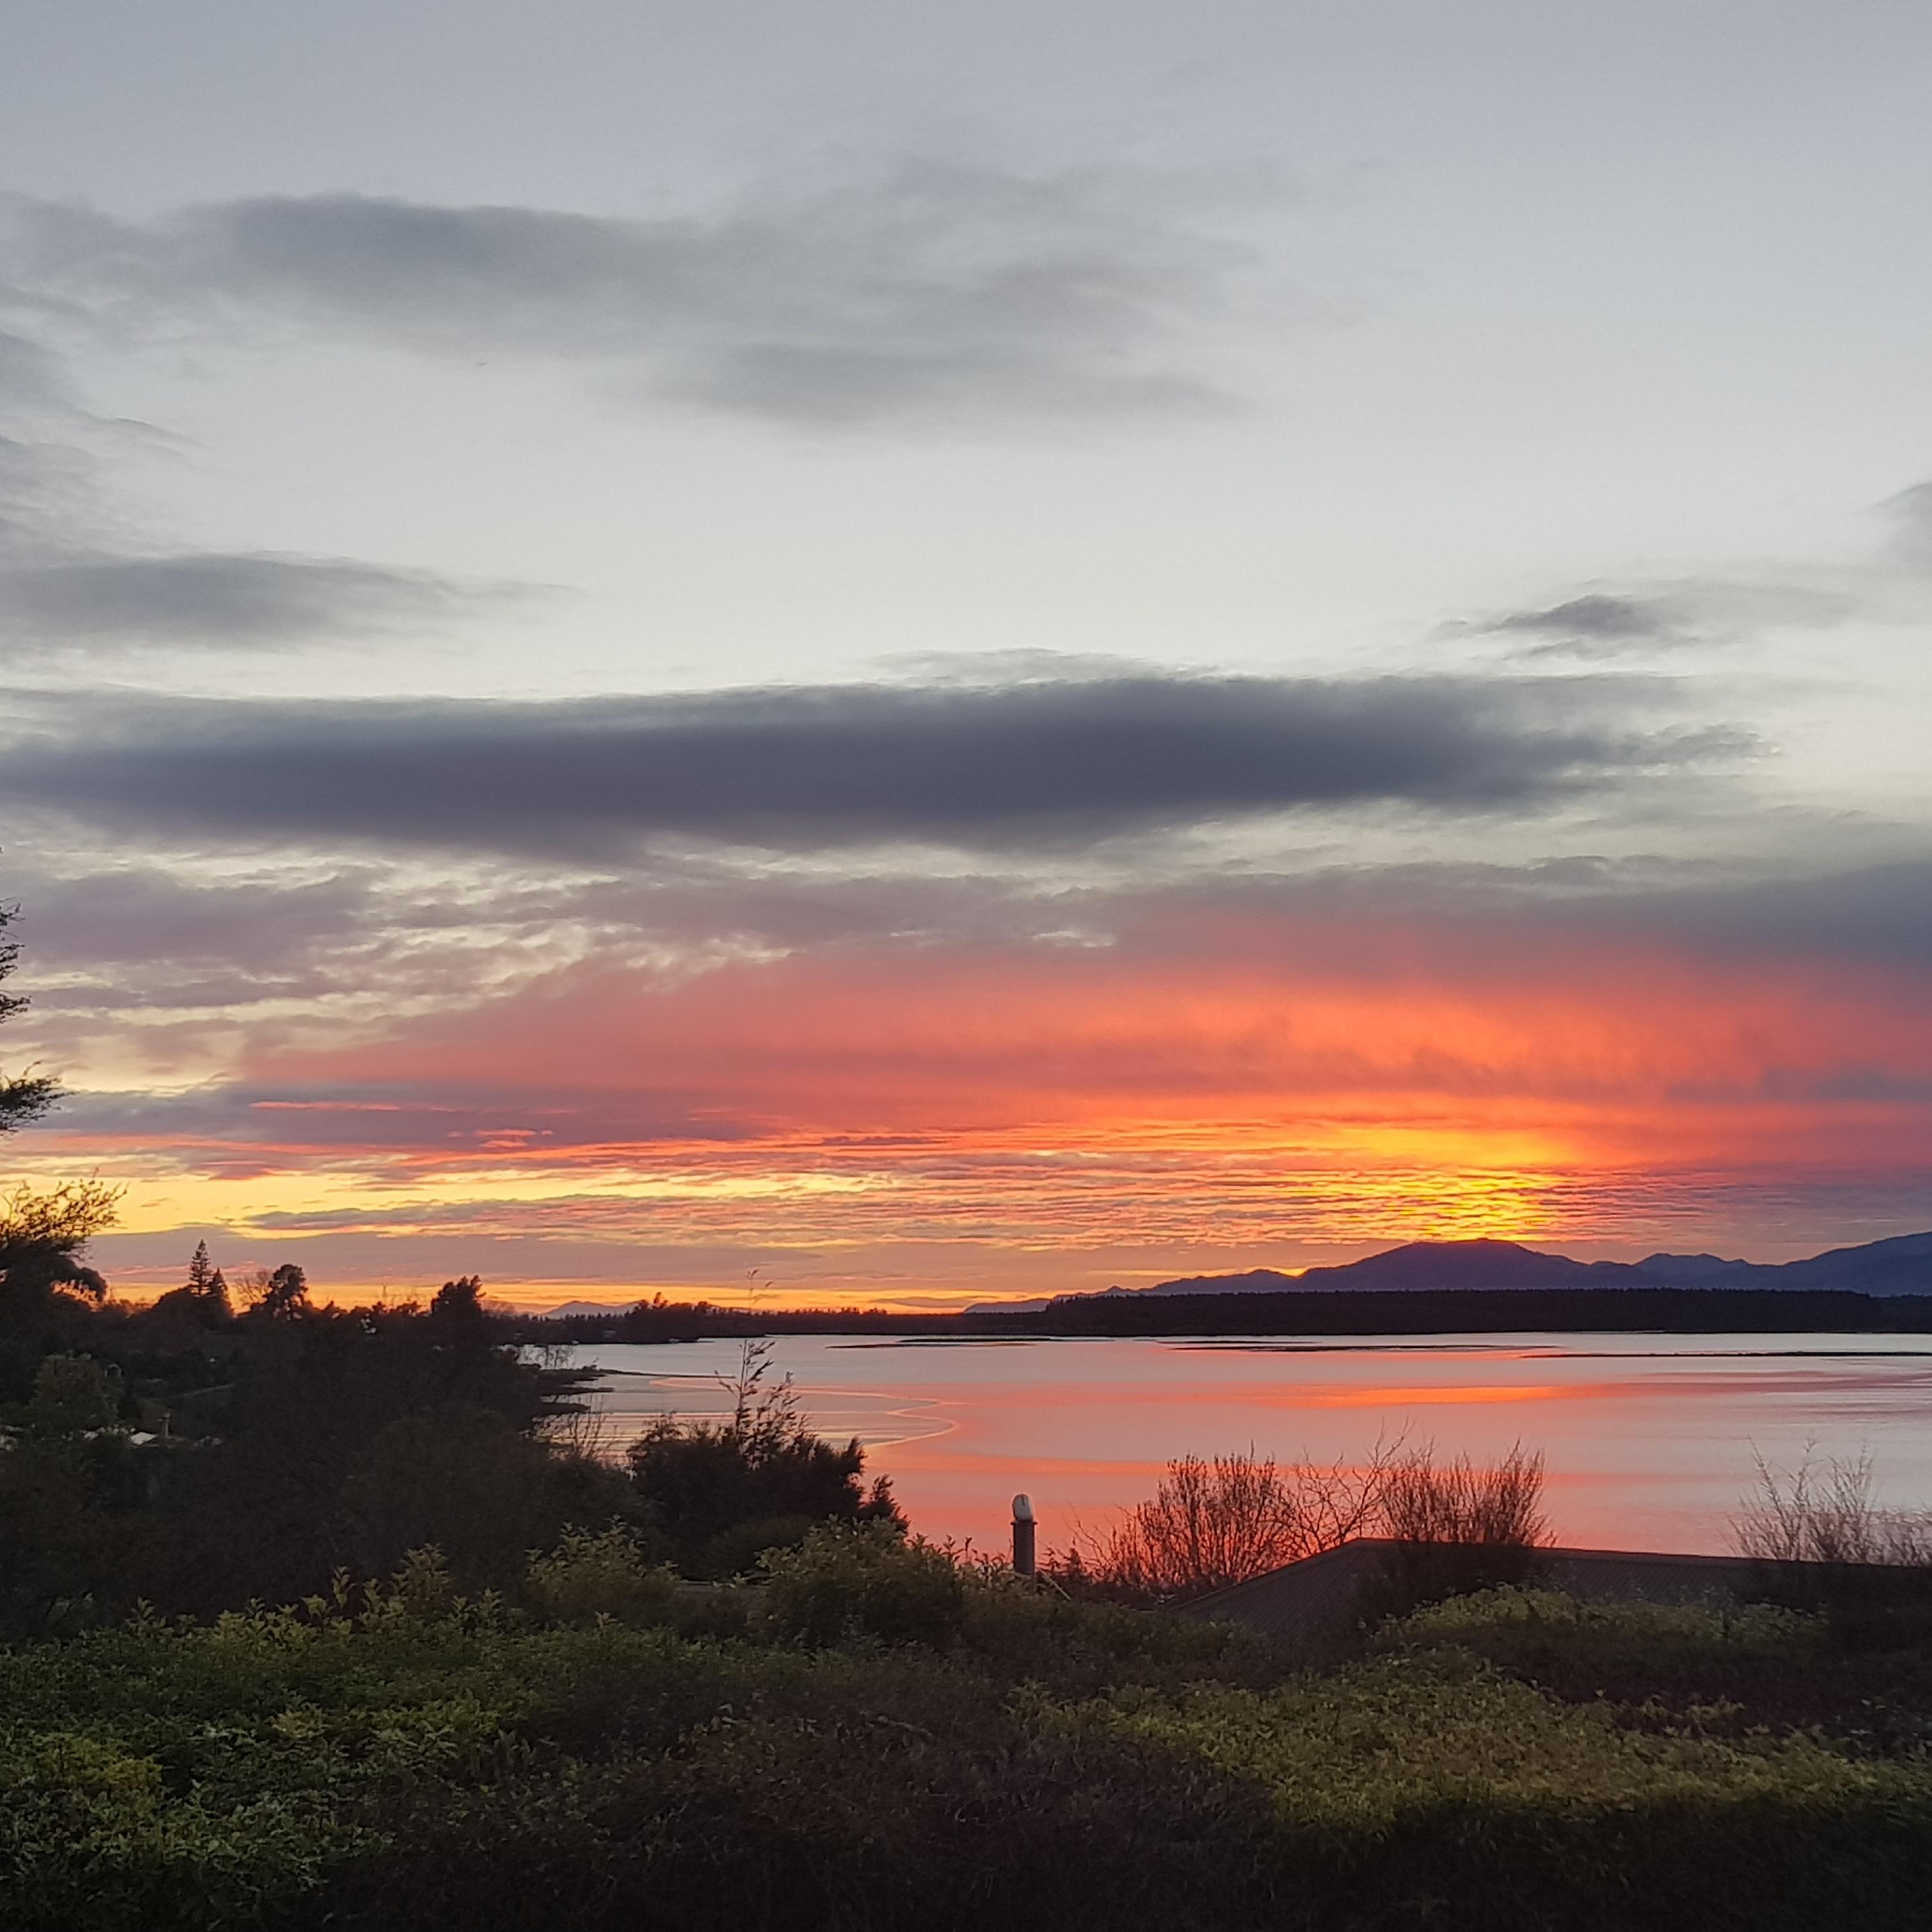
Āio ki te rangi
Āio ki te whenua
Āio ki te taiao
Āio ki ngā tangata katoa
Tihei Mauri Ora

Slide 2
E Kore E Kore
E Pō E Pō
E Ao E Ao
Tākiri mai te Ata
Kōrihi te Manu
Tino Awatea
Ka Ao Ka Ao
Ka Awatea
Tihei Mauri Ora!

Slide 3
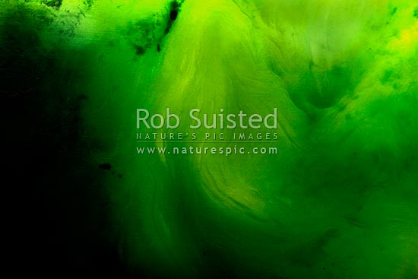
Kia hora te marino
Kia whakapapa pounamu te moana
Hei huarahi mā tātou i te rangi nei
Aroha atu, aroha mai
Tātou i a tātou katoa
Hui e, tāiki e

Slide 4
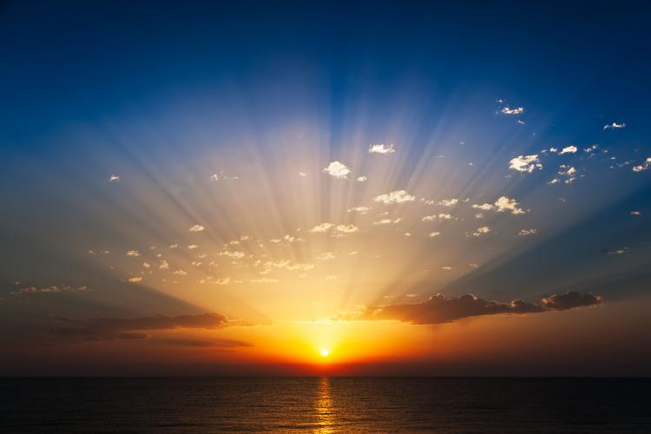
Tuia i runga
Tuia i raro
Tuia i waho
Tuia i roto
Tuia te here tāngata
Ka rongo te pō
Ka rongo te ao
Haumie
Hui e
Tāiki e
KARAKIA
A blessing to start
our session

Slide 5
Haukaha mai i runga
Haukaha mai i raro
Haukaha mai i roto
Haukaha mai i waho
Kia tau ai
Te Mauri Tū, Te Mauri Ora
ki te katoa.
Haumie, Hui e, Taiki e

Slide 6
KARAKIA TIMATANGA
A blessing to start our session
Whakataka te hau ki te uru
Whakataka te hau ki te tonga
Kia mākinakina ki uta
Kia mātaratara ki tai
E hī ake ana te atākura
He tio, he huka, he hauhu
Tihei mauri ora

Slide 7
E Kore E Kore
E Pō E Pō
E Ao E Ao
Tākiri mai te Ata
Kōrihi te Manu
Tino Awatea
Ka Ao Ka Ao
Ka Awatea
Tihei Mauri Ora!
The Void, the Nothing, the Potential
Many layers of Nights and Unknowing
The Light, the world of Becoming
The flesh of the sky is painted
Birds chorus greetings and awe
Light and Enlightenment
It is the world forming anew
The Dawn is here, A New Day
This is Life in full vitality!

Slide 8
Peace to the sky
Peace to the earth
Peace to the natural world
Peace to all humanity
Embrace the breath of life

Slide 9
Bind from above
Bind from below
Bind from the outside
Bind from within
Weaving the strands of humanity
Sense peace throughout night/dark
Sense peace throughout day/light
Draw together
Gather in
Affirm!

Slide 10
May peace be widespread
May the sea be like greenstone
A pathway for us all this day
Let us show respect and love
For each other, for us all
Bind together, Affirm!

Slide 11
KARAKIA TIMATANGA
A blessing to start our session
Whakataka te hau ki te uru
Whakataka te hau ki te tonga
Kia mākinakina ki uta
Kia mātaratara ki tai
E hī ake ana te atākura
He tio, he huka, he hauhu
Tihei mauri ora
Cease the winds from the west
Calm the winds from the south
Let breezes blow over the land
Let breezes blow over the ocean
Let the red-tipped dawn come
With sharpened air, a touch of frost,
the promise of a glorious day

Slide 12
Be strengthened from (sky) above
Be strengthened from (earth) below
Be strong within yourself
Draw strength from the environment
Vitality!
Wellbeing!
For All.
Strengthened in Unity

